Slide 1

Minimum Enclosing Ball for Anomaly Detection using Frank Wolfe Variants
Project by :
Dejan Dichoski
Marija Cveevska
Suleyman Erim
Mentor :
Prof. F. Rinaldi
University of Padova

Slide 2
introduction
Minimum enclosing balls (MEBs) provide a very versatile data representation for a wide range of learning and analysis tasks. Use cases include accelerated training of support vector machines or other classifiers, analysis of data streams, and the use case that is the topic of our project - anomaly detection.
While there exists a whole spectrum of algorithms for estimating the MEB of a given data set, a particularly general approach is to formalize the problem in terms of constrained quadratic optimization and we, too, will adhere to this strategy.
We will adapt three algorithms with the goal of solving MEB problem and we will test them on artificial and real-world datasets for detecting anomalies. Finally, we will compare our results.

Slide 3
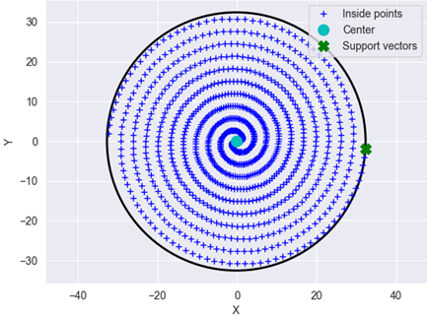
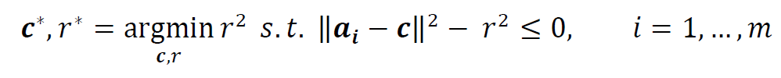
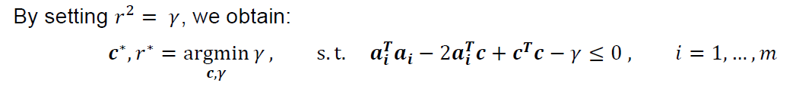
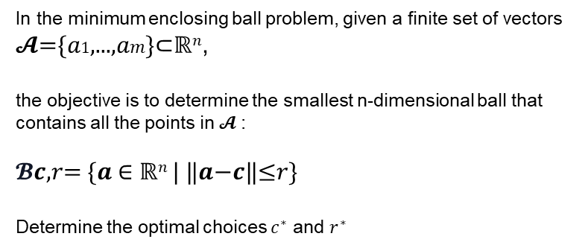
The primal meb problem
In the minimum enclosing ball problem, given a finite set of vectors
𝓐={𝑎1,...,𝑎𝑚}⊂ℝ^{𝑛},
the objective is to determine the smallest n-dimensional ball that contains all the points in 𝓐 :
𝓑𝒄,𝑟= {𝒂 ∈ ℝ^{𝑛} | ‖𝒂−𝒄‖≤𝑟}
Determine the optimal choices $c^{∗}$ and $r^{∗}$

Slide 4
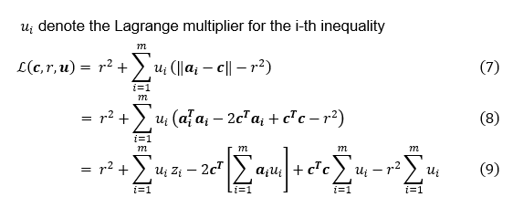
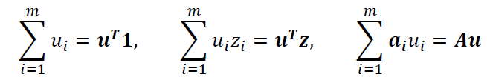
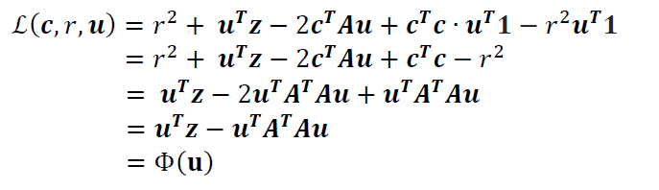
The DUAL meb problem
2
we can write our Lagrangian even more compactly

Slide 5
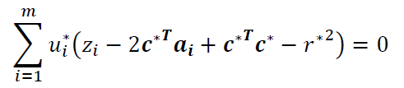


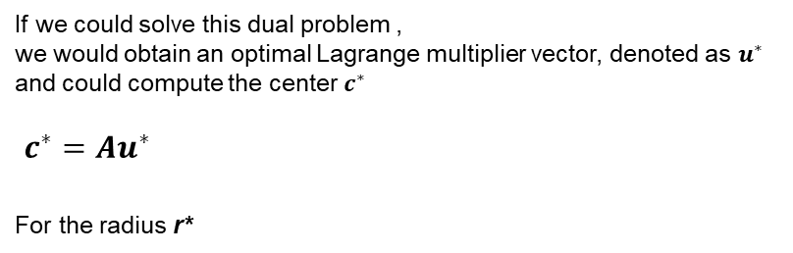
From Lagrange multipliers to MEB parameters
If we could solve this dual problem ,
we would obtain an optimal Lagrange multiplier vector, denoted as $u^{∗}$
and could compute the center $c^{∗}$
$c^{∗}=Au^{∗}$
For the radius r*

Slide 6
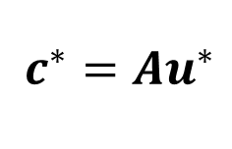
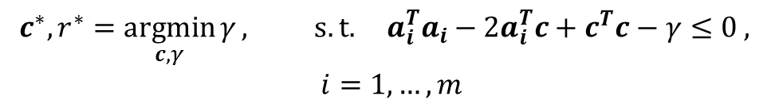
From Lagrange multipliers to MEB parameters
THE PRIMAL MEB PROBLEM
$$c^{∗}, r^{∗}=\underset{c, γ}{argmin}{γ}, s.t. a_{i}^{T}a_{i}−2a_{i}^{T}c+c^{T}c−γ≤0 ,$$
$$i=1,…, m$$
THE DUAL MEB PROBLEM
$c^{∗}=Au^{∗}$

Slide 7
algorithms
Frank wolfe
Frank Wolfe algorithm provides a straightforward approach for solving a convex minimization problem over a compact convex set
Away steps fw
A simple improvement over the zig zagging problem of FW algorithm with introducing the possibility of taking ‘away steps’ during optimization.
Blended pairwise conditional gradient
Combination of the Pairwise Conditional Gradient with the blending criterion from the Blended Conditional Gradients Algorithm that eliminates the occurrence of swap steps.
(1+ epsilon) approximation of meb
It exploits the special structure of the MEB dual formulation and can geometrically be viewed as generating a sequence of trial balls until a ball with desired properties is computed.

Slide 8
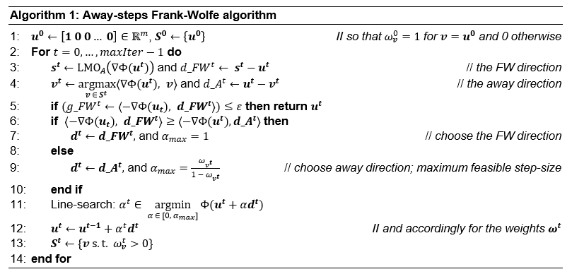
Away steps frank wolfe

Slide 9
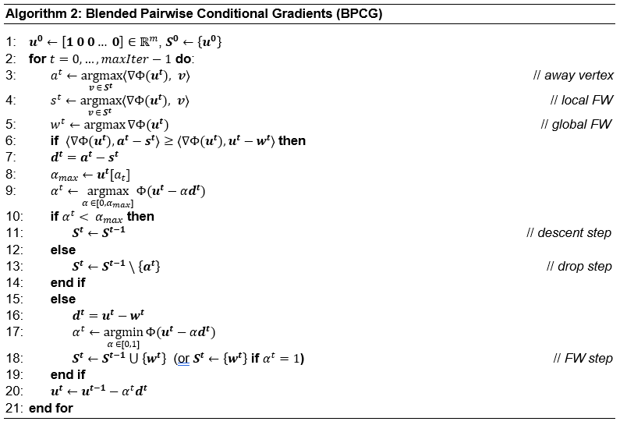
Blended pairwise conditional gradient

Slide 10
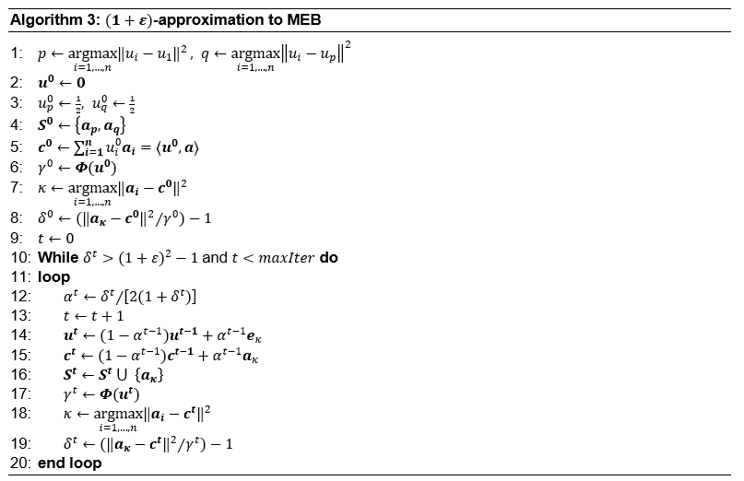
(1+ epsilon) approximation of meb
// Feasible solution
// Assign core set
// Assign center
// Assign r²
// Find furthest point index
// Find error bound
// Update learning rate
// Update Lagrangian Multipliers
// Update center
// Update core set
// Update r²
// Find furthest point index
// Find error bound

Slide 11
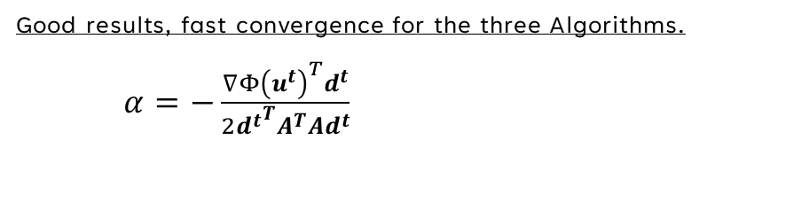
Line search strategies
Inverse time decay
Initial strategy, satisfactory radius and center parameters, but didn’t converge
Golden section search
Good results with Algorithm 1 but didn’t converge with Algorithm 2.
Armijo’s rule
Even though the obtained results for the center and radius were close to the optimal ones, it was evident that this line search strategy is very slow, and often failed to converge.
Exact line search
Good results, fast convergence for the three Algorithms.
$α=−\frac{{∇Φ\left(u^{t}\right)}^{T}d^{t}}{2{d^{t}}^{T}A^{T}Ad^{t}}$

Slide 12
EXPERIMENTS
The experiments aim to assess the quality of our three algorithms on both synthetic and real-world datasets.
The experimental section consists of two parts:
Training and testing the algorithms on synthetic datasets.
Training and testing the algorithms on real-world datasets, also incorporating epsilon (ε) as a variable hyperparameter.
data
GENERATED DATA
REALWORLD DATASETS
Uniform Distributed Data
Gaussian Distributed Data
Breast Cancer Wisconsin Dataset
Customer Churn Dataset

Slide 13
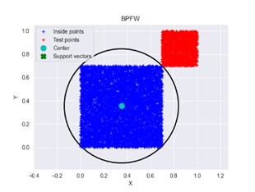
EXPERIMENT UNIFORM DATASET
 | TRAIN |  |  |  | TEST
 | ITTERATIONS | CPU TIMES (S) | RADIUS | ACTIVE SET SIZE | RECALL (%) | F1 SCORE (%)
ASFW | 379 | 23.632 | 1.019375 | 15 | 100 | 100
BPCD | 272 | 16.606 | 1.019365 | 14 | 100 | 100
APPFW | 747 | 22.108 | 1.019697 | 18 | 100 | 100
We created two closely spaced yet separable clusters:
- one for training with 8000 data points sampled from U[0.0, 0.7), and
- one for testing (containing anomalies) with 2000 points sampled from U[0.7, 1.0).
The blue cluster represents nominal points, while the red one represents anomaly points. The circle shows the MEB constructed by Algorithm 2

Slide 14
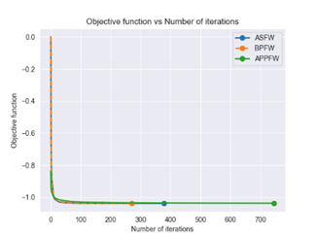
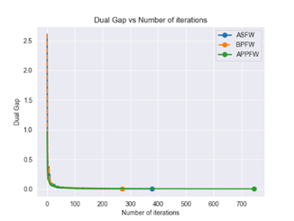
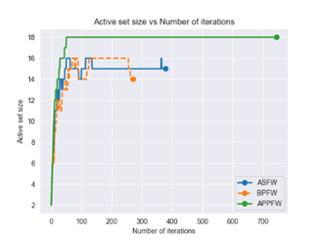
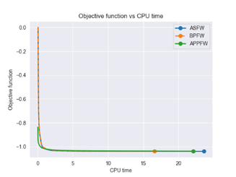
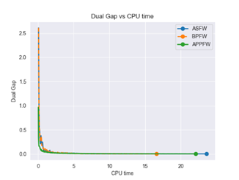
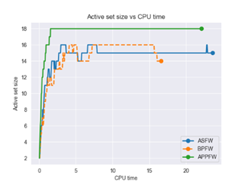
interpretation uniform dataset

Slide 15
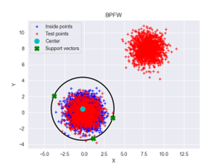
EXPERIMENT GAUSSIAN DATASET
 | TRAIN |  |  |  | TEST
 | ITTERATIONS | CPU TIMES (S) | RADIUS | ACTIVE SET SIZE | RECALL (%) | F1 SCORE (%)
ASFW | 177 | 9.614 | 5.45032 | 9 | 100 | 99.85
BPCD | 130 | 7.219 | 5.45032 | 9 | 100 | 99.85
APPFW | 733 | 21.904 | 5.45191 | 12 | 100 | 99.85
We created two very separable clusters:
- one for training with 8000 data points sampled from N(0, 1), and
- for testing 1000 points were sampled from N(0, 1), and 1000 from N(7, 1).
The blue cluster represents training points, while the red one represents test points. The circle shows the MEB constructed by Algorithm 2.
Support vectors are training points that lie on the boundary (MEB). The red points around the center of the MEB are test points belonging to the nominal class, while the red cluster on the top right represents the anomaly points in the test set.

Slide 16
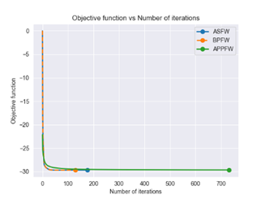
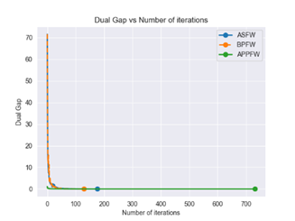
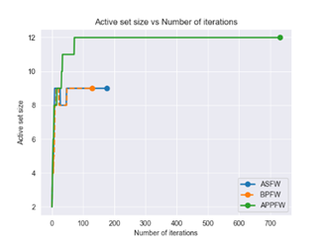
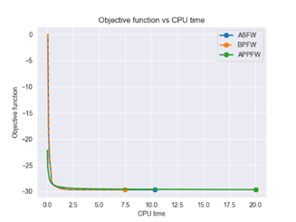
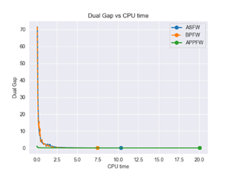
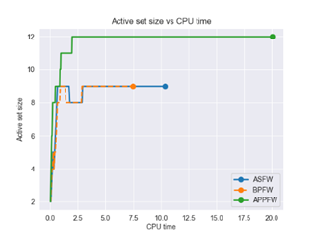
Interpretation gaussian dataset

Slide 17
Experiment breast cancer dataset
The “Breast Cancer Wisconsin (Diagnostic)”, sourced from Kaggle, provides a comprehensive collection of information derived from digitized images of fine needle aspirates (FNA) of breast masses.
Distinguishing between
malignant cases
benign cases of breast cancer.
This dataset consists of :
569 samples
32 features.
It comprises of:
357 benign cases
212 malignant cases.
To create training and testing datasets we first separated
nominal data (benign cases)
anomaly data (malignant cases).
Training data: Half of the nominal data (178 samples)
Testing data: 391 samples (179 nominal and 212 anomalies).
Various thresholds (ε) were employed as stopping criteria, and these are reported in Table 3.

Slide 18
EXPERIMENT BREAST CANCER DATASET
TRAIN |  |  |  |  |  | TEST
 | EPSILON | ITTERATIONS | CPU TIMES (S) | RADIUS | ACTIVE SET SIZE | FN | FP | RECALL(%) | F1 SCORE (%)
ASFW | 0.1 | 64 | 26.38 | 11.077366 | 6 | 50 | 5 | 76.415 | 85.488
ASFW | 0.01 | 92 | 36.97 | 11.077386 | 6 | 50 | 5 | 76.415 | 85.488
ASFW | 0.001 | 118 | 98.634 | 11.077386 | 6 | 50 | 5 | 76.415 | 85.488
BPFW | 0.1 | 32 | 18.165 | 11.077378 | 6 | 50 | 5 | 76.415 | 85.488
BPFW | 0.01 | 50 | 24.112 | 11.077386 | 6 | 50 | 5 | 76.415 | 85.488
BPFW | 0.001 | 66 | 31.402 | 11.077386 | 6 | 50 | 5 | 76.415 | 85.488
APPFW | 0.1 | 4 | 2.004 | 11.758557 | 5 | 59 | 3 | 72.17 | 83.152
APPFW | 0.01 | 35 | 11.0 | 11.130932 | 7 | 50 | 5 | 76.415 | 85.488
APPFW | 0.001 | 608 | 146.278 | 11.080393 | 7 | 50 | 5 | 76.415 | 85.488

Slide 19
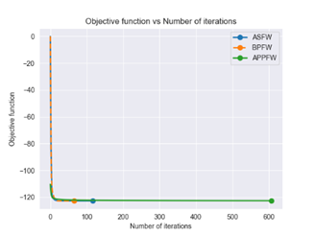
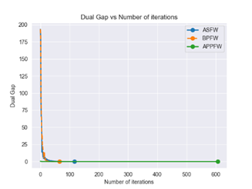
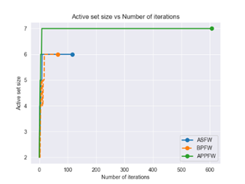
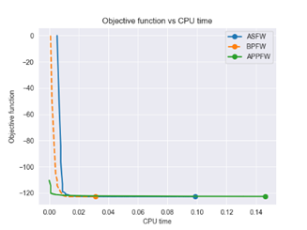
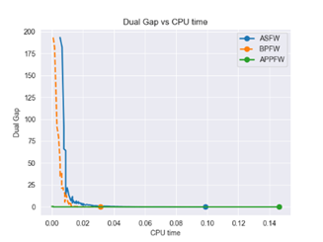
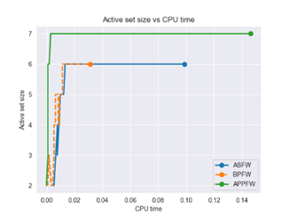
interpretation breast cancer dataset

Slide 20
Experiment customer churn dataset
The "Iranian Churn Dataset" from the UCI Machine Learning Repository is a collection of data randomly gathered from a telecommunications company in Iran, spanning a period of 12 months.
Distinguishing between:
Customers who have discontinued their services.
Customers who have not discontinued their services.
This dataset consists of :
3,150 samples, with each sample representing a unique customer
14 features
It comprises of:
2659 cases that didn’t churn
491 churn cases.
To create training and testing datasets, we first separated:
nominal data (no churn)
anomaly data (churn).
Training data: Half of the nominal data (1327 samples) the
Testing data: 1823 samples (1327 nominal and 495 anomalies).

Slide 21
EXPERIMENT CUSTOMER CHURN DATASET
TRAIN |  |  |  |  |  | TEST
 | EPSILON | ITTERATIONS | CPU TIMES (S) | RADIUS | ACTIVE SET SIZE | FN | FP | RECALL(%) | F1 SCORE (%)
ASFW | 0.1 | 55 | 131.633 | 6.708818 | 6 | 445 | 2 | 10.101 | 18.282
ASFW | 0.01 | 80 | 154.788 | 6.709065 | 6 | 447 | 2 | 9.697 | 17.615
ASFW | 0.001 | 100 | 217.184 | 6.709067 | 6 | 447 | 2 | 9.697 | 17.615
BPFW | 0.1 | 32 | 74.47 | 6.709004 | 6 | 448 | 3 | 9.495 | 17.248
BPFW | 0.01 | 40 | 97.306 | 6.709067 | 6 | 447 | 2 | 9.697 | 17.615
BPFW | 0.001 | 54 | 116.559 | 6.709067 | 6 | 447 | 2 | 9.697 | 17.615
APPFW | 0.1 | 3 | 5.293 | 7.184624 | 4 | 491 | 1 | 0.808 | 1.6
APPFW | 0.01 | 13 | 14.184 | 6.753838 | 6 | 454 | 1 | 8.283 | 15.27
APPFW | 0.001 | 178 | 178.887 | 6.711496 | 7 | 447 | 2 | 9.697 | 17.615

Slide 22
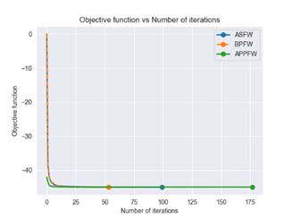
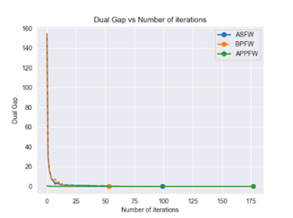
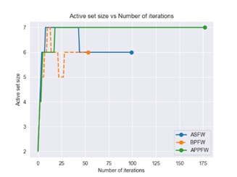
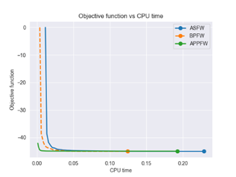
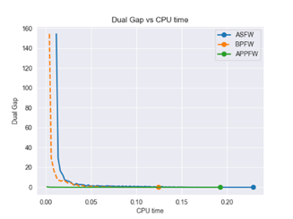
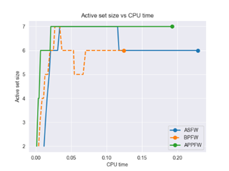
interpretation customer churn dataset

Slide 23
conclusion
We implemented three adaptations of the Frank Wolfe algorithm:
BPCG, Away-steps Frank Wolfe, and (1+ε)-approximation to MEB.
BPCG consistently outperformed the others in terms of metrics such as iterations, CPU time, and active set size, displaying a superior convergence rate.
Away-steps FW also yielded satisfactory results, highlighting its improvement over the vanilla FW algorithm.
(1+ε)-approximation to MEB initially underperformed with a strict stopping criterion but showed significant improvement with a larger ε value.
Ultimately, our evaluation on different datasets emphasized the importance of selecting optimization algorithms based on the dataset's characteristics, as algorithm performance is highly dependent on data structure.

Slide 24
THANK YOU for your attention
You can find the project at the following link

